Slide 1
WHITE PAPER TASK

Slide 2
TOPIC
WEATHER DERIVATIVES
THEIR MODEL AND PRICING

Slide 3
WHY WEATHER DERIVATIVES?
Farmers can use weather derivatives to hedge against poor harvests caused by failing rains during the growing period, excessive rain during harvesting, high winds in case of plantations or temperature variabilities in case of greenhouse crops; theme parks may want to insure against rainy weekends during peak summer seasons; and gas and power companies may use them to smooth earnings. A sports event managing company may wish to hedge the loss by entering into a weather derivative contract because if it rains the day of the sporting event, fewer tickets will be sold.

Slide 4
INTRODUCTION TO WEATHER DERIVATIVES

Slide 5
WHAT IS A WEATHER DERIVATIVE?

Slide 6
A weather derivative is a financial instrument used by companies and individuals to hedge against the risk of weather related losses.
In 1997, they began being traded OTC and within a few years they had become tradeable on an exchange and treated by some HFs as an investment class.
The CME lists weather future contracts for a few dozen cities, majority of them in US.
Investors who like them appreciate their low correlation with the traditional markets.

Slide 7
Weather derivatives vs insurance
While insurances are used to hedge against low probability catastrophic weather events like hurricanes, earthquakes etc. weather derivatives are used to hedge against high-probability events such as dryer than expected summer.
One major difference between the two is that in insurance, one has to show the real damage that might have occurred due to the catastrophe but in weather derivatives, they are traded by index. It does not matter if the adverse weather condition like extreme heat has caused any damage.

Slide 8
Working of Weather derivatives
Weather derivatives work somewhat similar to traditional derivatives except that they work on different underlying asset and index and have different payoff relations.
A weather derivative buyer earns money in case of adverse weather condition while a seller earns a premium.

Slide 9
Types of weather derivatives
FORWARDS
FUTURES
OPTIONS
SWAPS

Slide 10
While these derivatives can be traded on any parameter like temperature, snow, rainfall, humidity etc. we will explicitly deal with temperature.

Slide 11
Calculation:
Weather derivatives are calculated in terms of degree days.
Mainly HDD(Hot Degree Days) in winter and CDD( Cooling Degree Days) in summer.

Slide 12
Formula
T=(T1+T2)/2
T-Daily avg. temp
T1-Max temp during day
T2-Min temp during day
HDDi =max{18 − Ti , 0},
And
CDDi =max{Ti − 18, 0}

Slide 13
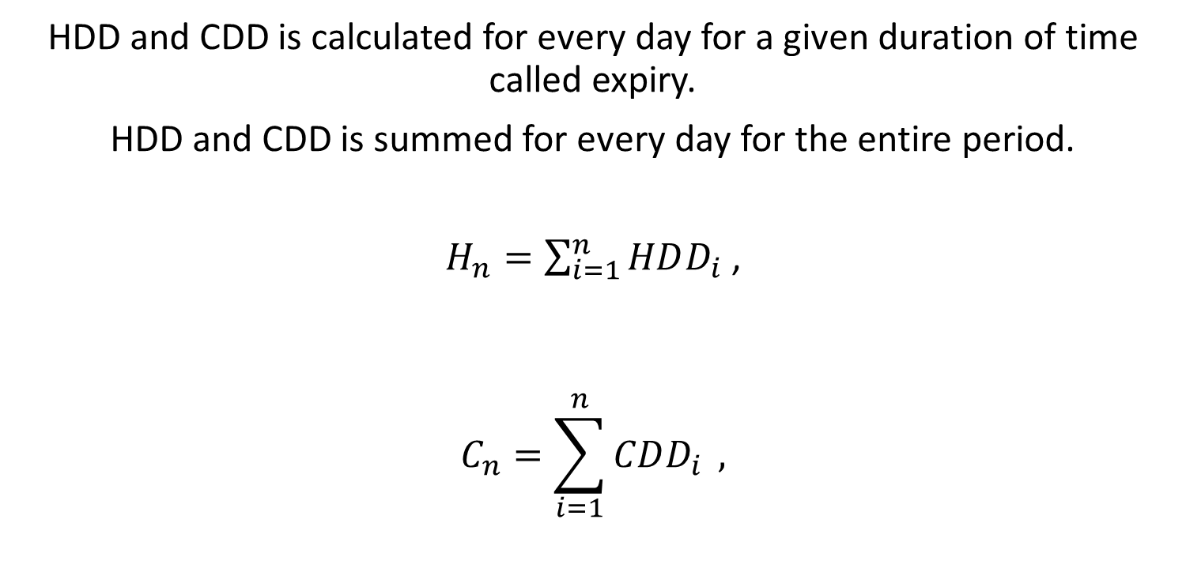
Continued
HDD and CDD is calculated for every day for a given duration of time called expiry.
HDD and CDD is summed for every day for the entire period.
$H_{n}=\sum_{i=1}^{n}{HDD_{i}}$ ,
$$C_{n}=\sum_{i=1}^{n}{CDD_{i}} ,$$

Slide 14
Payout for an uncapped HDD call can be defined as :
X = α max {Hn − K, 0} .
Where K = Strike Price
And similarly for CDD in summers.

Slide 15
Example of a weather call:
Say I am an energy owner who sells heaters in winters. I fear a poor winter as in high average temperatures during the season that can cause my sales to decline and and hence loss.
But, I can hedge my risk buy selling a weather call of HDD.
So, if it’s a good cold winter I can pay the buyer the price of the contract from the good profits I had . Also, if it is a poor winter and my business goes down I am able to pocket the premium.

Slide 16
Example of weather put option:
Tom, a farmer fears a mild summer that can potentially harm his crops. So he can buy a weather put in CDD.
So, if it is a normal summer, crops are good and he can pay the premium to the seller from the proceeds.
In case his fear manifests, he can hedge the risk by pocketing all the profit of the put contract. Note that it is not necessary that his crops actually damage but his seller would be obliged to pay him the money.

Slide 17
Pricing the Contract
Now it becomes necessary to model the temperature or daily average temperature to be specific as it is the daily average temperature that defines the price of the contract.
Temperature can be modelled by collecting historical temperature data from trusted weather websites and modelling the average temperature of any given day t with the help of mathematics.

Slide 18
Math
Basically we model the avg. temp. by Ornstein–Uhlenbeck dynamics, which is a stochastic differential equation.
Roughly speaking, it is a Gauss-Markov process that over time, drifts towards its long time mean, as in, it is a mean reverting process.
Gauss-Markov Process- In stats, it is a process that states that ordinary least squares(OLS) estimator has the minimum sampling variance within the class of linear unbiased estimators.

Slide 19
Parameters
For a particular location, let
T(t) denote the daily average temperature on day t.
s(t) be a deterministic function, describing the seasonal variation. The temperature reverts on day t to the mean level.
a(t) denote the rate of mean-reversion on day t.
σ(t) denote the volatility of daily temperature fluctuations. It is a seasonal function, taking into account the variation in volatility throughout the year.

Slide 20
Equations
We model the temp. by the stochastic differential:
dT(t) = a(T (m) − T(t))dt + σ(t)dW(t)
Where T(m) is the long run mean that we talked about.
Actually, this too is time dependent.
We conclude this by the time series modelling of temperature (graphically) and model it by using :
T(m) = A + Bt + C sin(ωt + ϕ).
We find that the temperature graph shows T(m) varies seasonally (hence, the sine part) , with a weak but positive linear trend.
ω=2pi/365

Slide 21
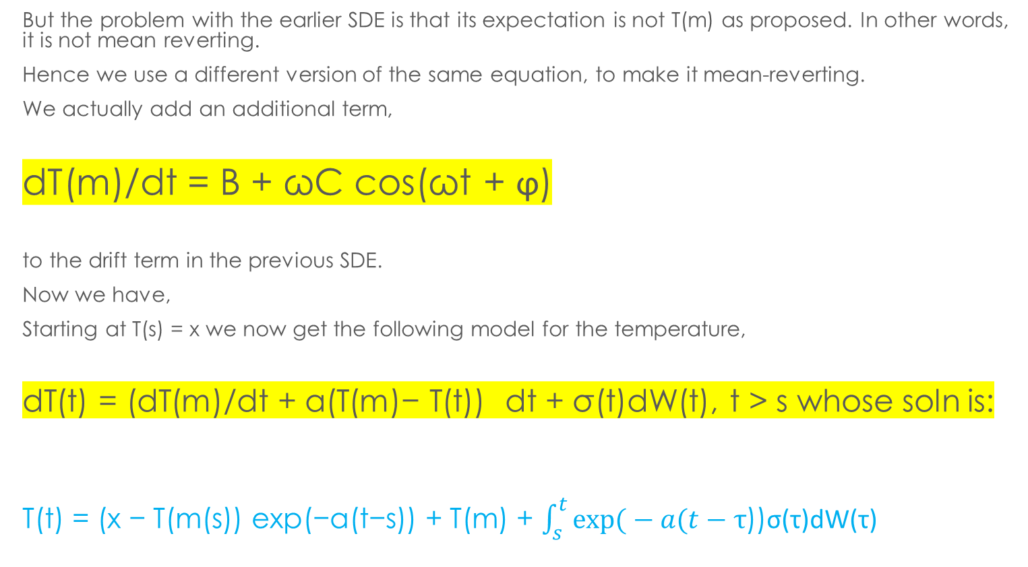
Solution to the SDE:
But the problem with the earlier SDE is that its expectation is not T(m) as proposed. In other words, it is not mean reverting.
Hence we use a different version of the same equation, to make it mean-reverting.
We actually add an additional term,
dT(m)/dt = B + ωC cos(ωt + ϕ)
to the drift term in the previous SDE.
Now we have,
Starting at T(s) = x we now get the following model for the temperature,
dT(t) = (dT(m)/dt + a(T(m)− T(t)) dt + σ(t)dW(t), t > s whose soln is:
T(t) = (x − T(m(s)) exp(−a(t−s)) + T(m) + $\int_{s}^{t}{exp⁡(}−a(t−τ$))σ(τ)dW(τ)

Slide 22
Estimation of parameters.
a(t) or rate of mean reversion can be calculated by carrying out Euler-discretization followed by lag analysis using PACF.
Also parameters in the T(m) function can be estimated by modelling time series data.
Finally volatility term too can be calculated using a no of methods like parametric regression and Fourier series.

Slide 23
SOME TERMS
Euler Discretization is a numerical method to transfer continuous functions, models and equations into discrete counterparts to evaluate solution of differential equations.
PACF is partial autocorrelative function that is a statistical tool to evaluate the relationship between the values in a time series on a given day with the days prior to it.

Slide 24
The market for weather derivatives is a typical example of incomplete market as the underlying asset i.e. temperature is not tradeable. Therefore we consider a market price of risk λ, in order to obtain unique prices of such contracts. Since there is no real market from where we can obtain prices, we assume for simplicity that the market price for risk is constant. Also we assume a risk free asset paying r and a contract that for each degree C pays one unit of currency.

Slide 25
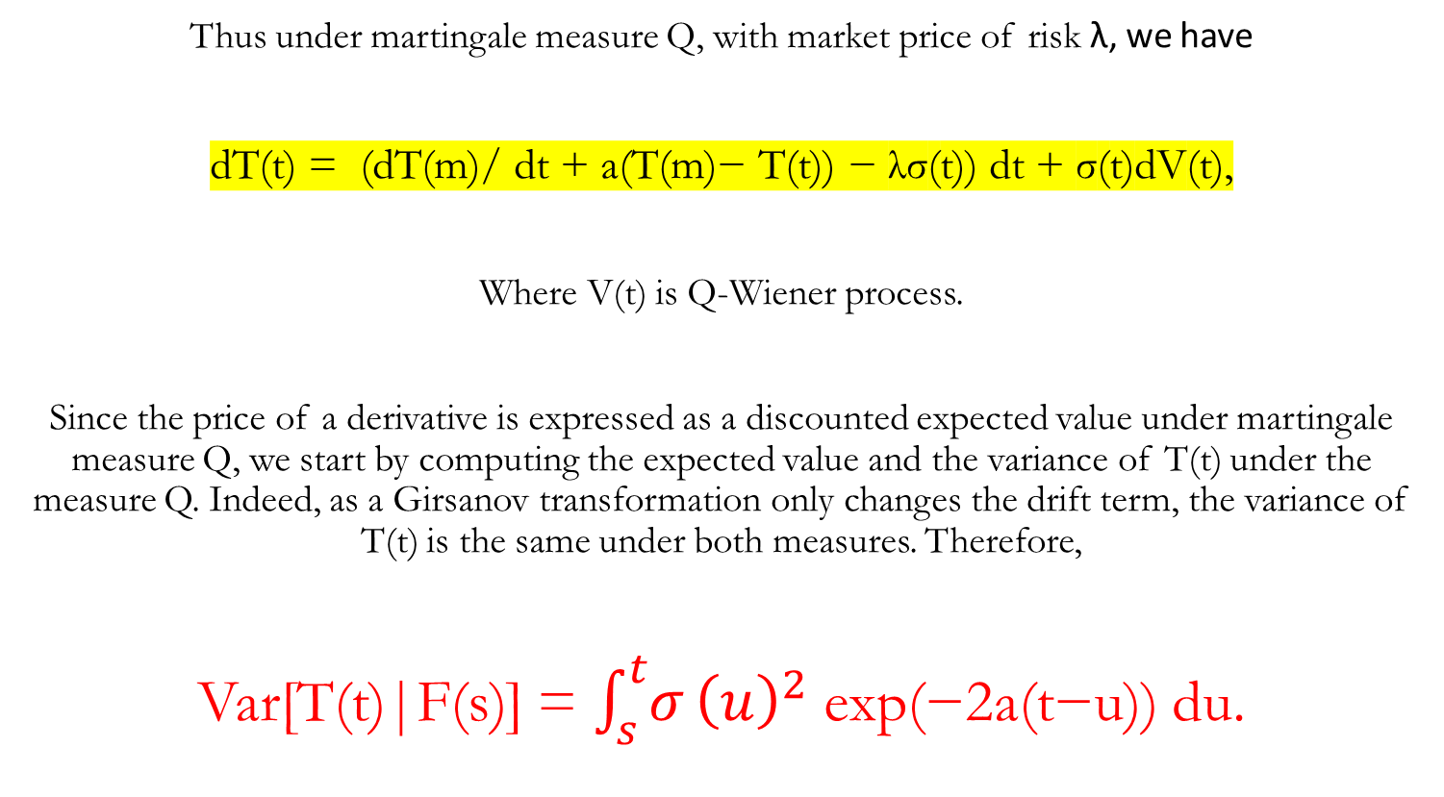
Pricing Continued:
Thus under martingale measure Q, with market price of risk λ, we have
dT(t) = (dT(m)/ dt + a(T(m)− T(t)) − λσ(t)) dt + σ(t)dV(t),
Where V(t) is Q-Wiener process.
Since the price of a derivative is expressed as a discounted expected value under martingale measure Q, we start by computing the expected value and the variance of T(t) under the measure Q. Indeed, as a Girsanov transformation only changes the drift term, the variance of T(t) is the same under both measures. Therefore,
Var[T(t)|F(s)] = $\int_{s}^{t}{σ}{\left(u\right)}^{2}$ exp(−2a(t−u)) du.

Slide 26
Q-WIENNER PROCESS
Q-Wienner process is nothing but the Brownian Motion or the random walk model we talk about when we describe stochastic processes. It takes some assumptions, the most prominent of which is that the increment term is independent of the past values and is normally distributed with mean 0 and variance 1.

Slide 27
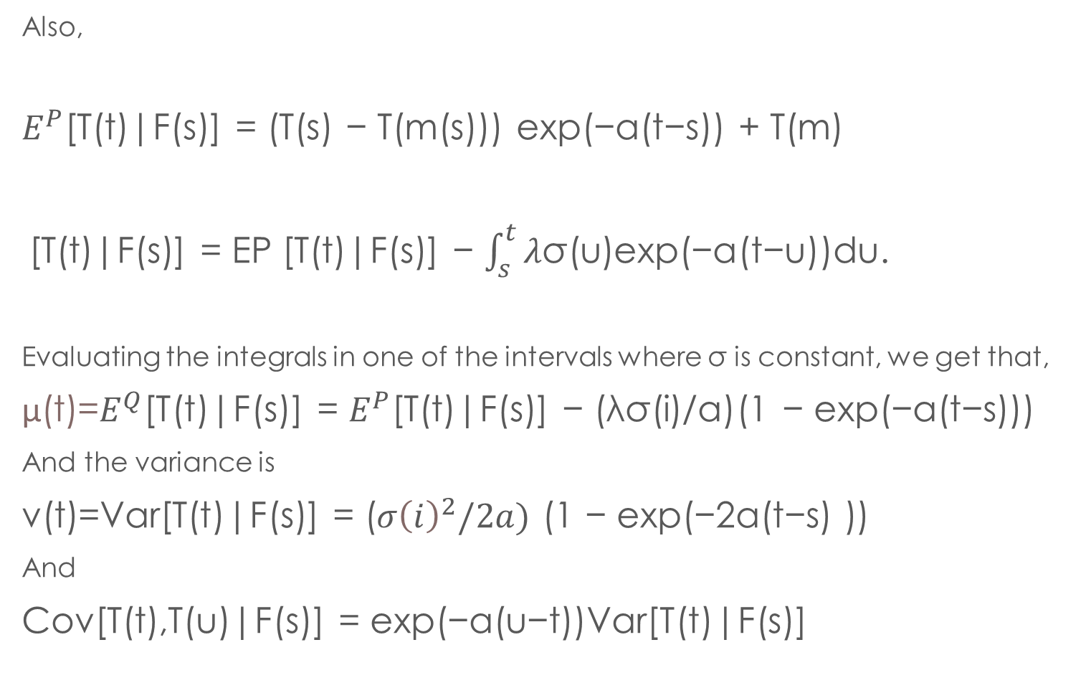
Also,
$E^{P}$[T(t)|F(s)] = (T(s) − T(m(s))) exp(−a(t−s)) + T(m)
[T(t)|F(s)] = EP [T(t)|F(s)] − $\int_{s}^{t}{λ}$σ(u)exp(−a(t−u))du.
Evaluating the integrals in one of the intervals where σ is constant, we get that,
μ(t)=$E^{Q}$[T(t)|F(s)] = $E^{P}$[T(t)|F(s)] − (λσ(i)/a)(1 − exp(−a(t−s)))
And the variance is
v(t)=Var[T(t)|F(s)] = ($σ{\left(ⅈ\right)}^{2}/2a)$ (1 − exp(−2a(t−s) ))
And
Cov[T(t),T(u)|F(s)] = exp(−a(u−t))Var[T(t)|F(s)]

Slide 28
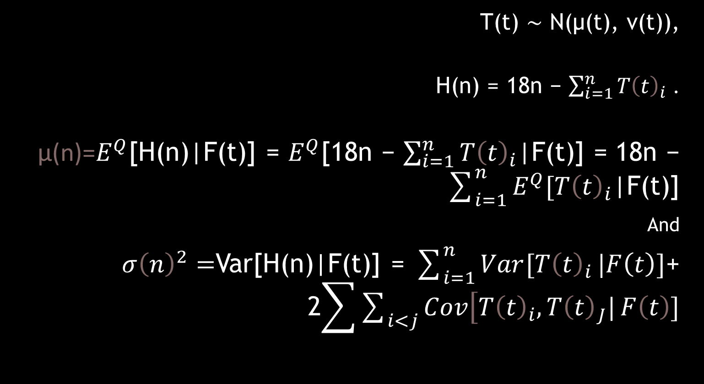
Pricing of HDD Call
T(t) ∼ N(µ(t), v(t)),
H(n) = 18n − $\sum_{i=1}^{n}{T{\left(t\right)}_{i}}$ .
μ(n)=$E^{Q}$[H(n)|F(t)] = $E^{Q}$[18n − $\sum_{i=1}^{n}{T{\left(t\right)}_{i}}$|F(t)] = 18n − $\sum_{i=1}^{n}{E^{Q}[T{\left(t\right)}_{i}}$|F(t)]
And
$σ{\left(n\right)}^{2}=$Var[H(n)|F(t)] = $\sum_{i=1}^{n}{Var[T{\left(t\right)}_{i}}|F\left(t\right)]$+ 2$\sum{\sum_{i<j}{\operatorname{Cov}\left[T{\left(t\right)}_{i},T{\left(t\right)}_{J}|\right.F\left(t\right)]}}$

Slide 29
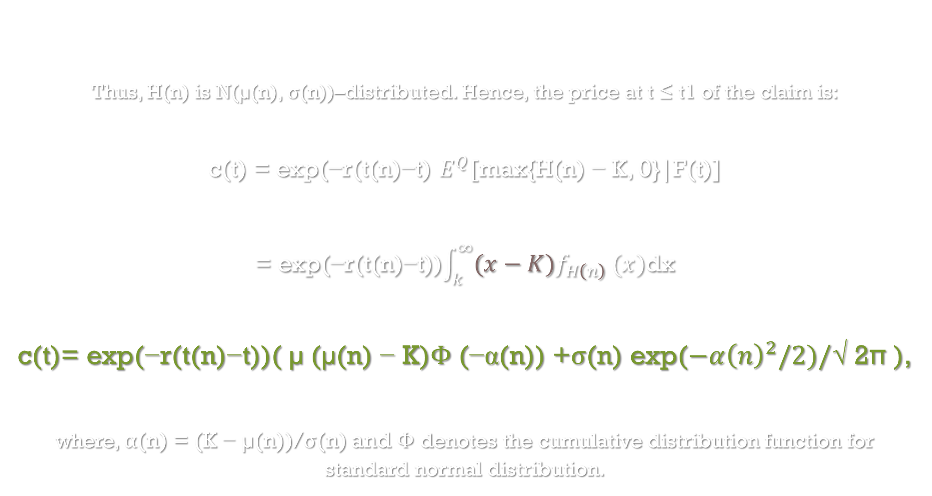
Thus, H(n) is N(µ(n), σ(n))–distributed. Hence, the price at t ≤ t1 of the claim is:
c(t) = exp(−r(t(n)−t) $E^{Q}$[max{H(n) − K, 0}|F(t)]
= exp(−r(t(n)−t))$\int_{k}^{∞}{{(x−K)f}_{H\left(n\right)}}(x)$dx
c(t)= exp(−r(t(n)−t))( µ (µ(n) − K)Φ (−α(n)) +σ(n) exp($−α{\left(n\right)}^{2}/2)/$√ 2π ),
where, α(n) = (K − µ(n))/σ(n) and Φ denotes the cumulative distribution function for standard normal distribution.

Slide 30
IMPLEMENTATION
https://colab.research.google.com/drive/1WN3keW0DlDlnh4Y9EG4jMVDGalV4ih42?usp=share_link

